Slide 1
Arts as Sanctuary in Berlin: Innovation in Arts Engagement and Integration for Refugees
Offered as IDFA 604 for 3 credits for Summer 2020
Taught by Kate Collins
At Towson University

Slide 2
A new and timely course.

Slide 4
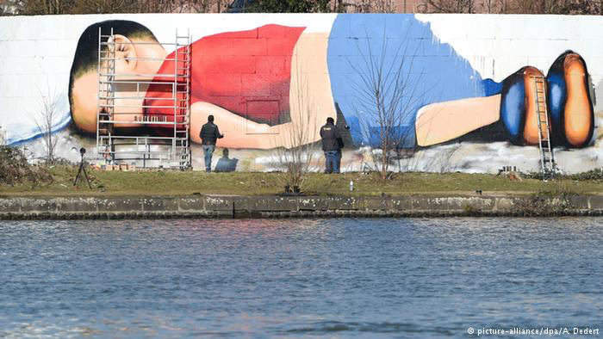

Slide 5
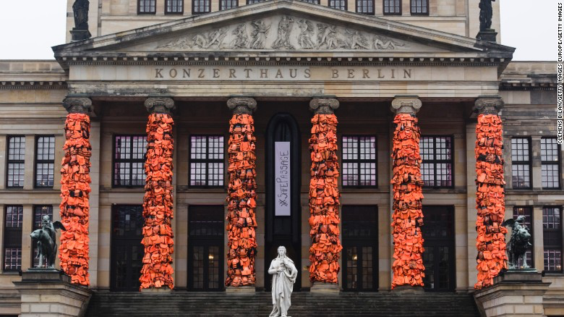

Slide 6
Dates
Study Abroad Applications Due – March 15
Depart U.S. - June 25
First Day in Berlin – June 26
AMAZING TIMES IN GERMANY!! June 26 – July 6
Depart for U.S. – July 7

Slide 7
Apply!
Apply online in Horizons – TU’s web-based study abroad management system no later than March 15, 2020
Application includes:
Transcript
Short answer questions
Emergency contact information
Statement of Responsibilities and Obligations
$250 deposit (refundable only if program cancelled)

Slide 8
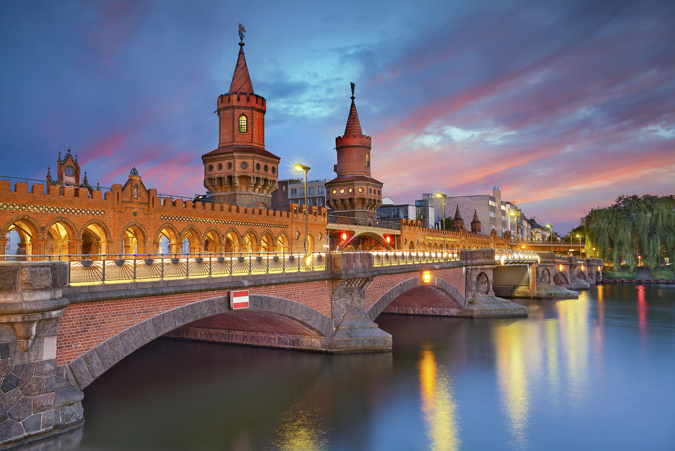
Notes:
Oberbaum Bridge

Slide 9
Itinerary
At this point, I’m just going to insert a few images from the first Arts as Sanctuary course in Berlin from Summer 2018 to give you a sense of our fantastic itinerary and the fun to be had…

Slide 10
Arts and Schools
Berlin’s East Side Gallery
Group visit to a local Gymnasium (high school)

Slide 11
Museum Visits
Pergamon Museum Tour
Workshop at Hamburg’s Kunstehalle

Slide 12
A fantastic public transportation system (involves plenty of walking)
Public Transportation Adventures
Spontaneous Train Station
Dance Lessons

Slide 13
Berlin Wall Memorial

Slide 14
Reichstag

Slide 15
Street Art Tour (one of the absolute favorite parts of the trip in 2018!)

Slide 16
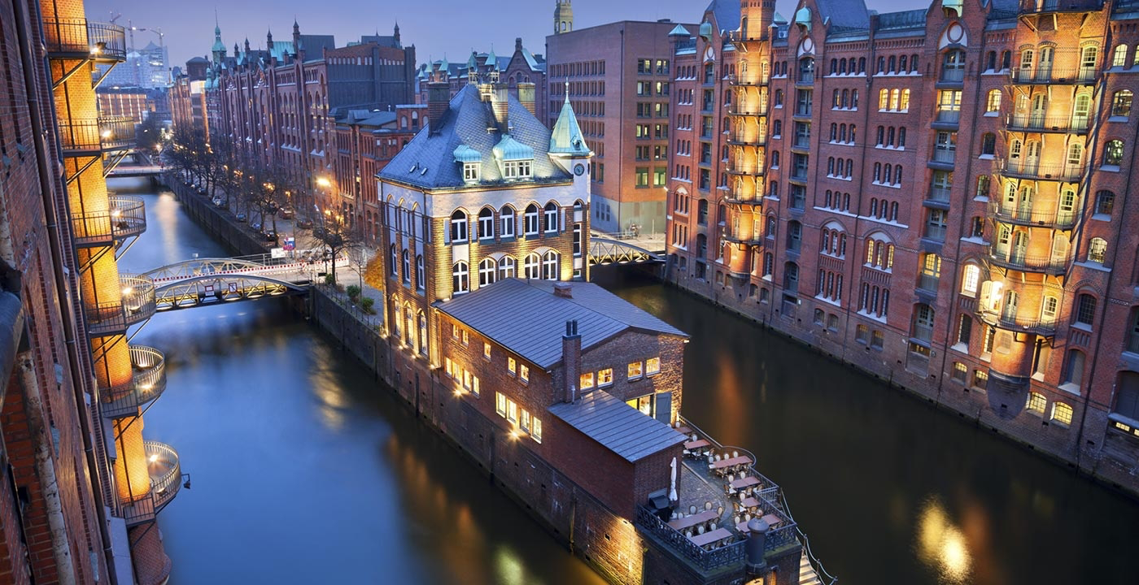
Hamburg

Slide 17
Expectations
3 credit graduate course
3 or 4 prep meetings before departing
Survival German lessons
Reflection Assignments
Readings & Daily Debriefing
Photo Essay/Blog – due two weeks after returning to U.S.

Slide 18
Accommodation

Slide 19
Expenses
Program Fee (estimate) | $3,500
Study Abroad Fee | $190
Meals (estimate) | $300
Airfare (estimate) | $1,300
Personal expenses (estimate) | $200
ESTIMATED TOTAL | $5,490

Slide 20
Scholarships/Aid
www.towson.edu/academics/international/abroad/scholarships.html

Slide 21
Questions?
Notes:
No Human Being is Illegal

Slide 22
Something else that might be helpful…
Consider looking up YouTube videos on Berlin, Hamburg and maybe some of the arts institutions we’re going to visit. That might be a fun and helpful way to get a deeper look into what you can look forward to on this trip!

